Slide 1
Hoop Dreams
Presentation by Eric Chen

Slide 2
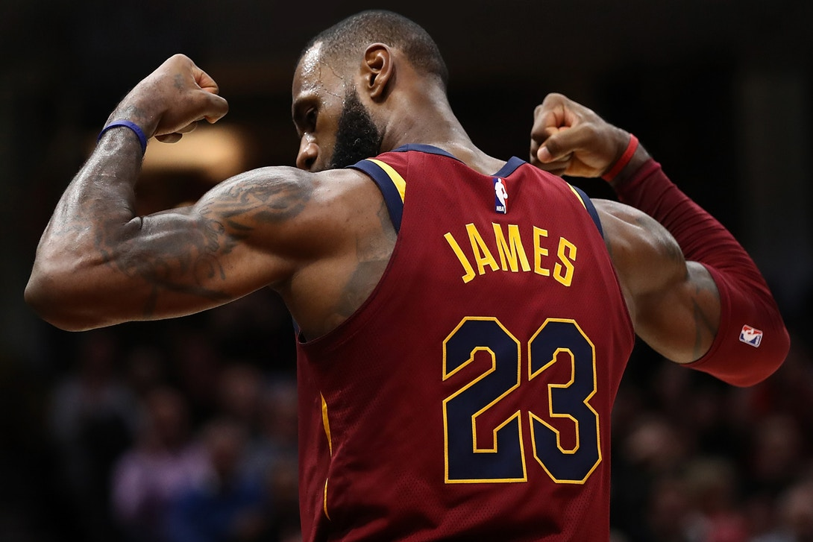
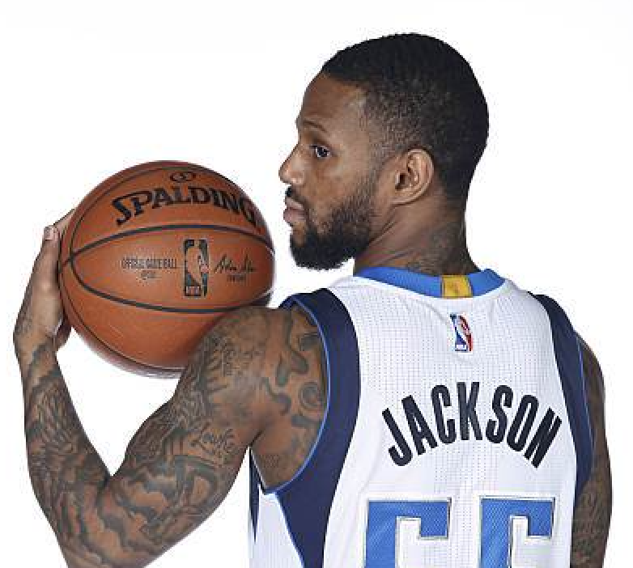
Overview
Salaries in the NBA
Lowest salary - Pierre Jackson $31,969
Highest Salary – LeBron James $30,963,450
Median Salary - $7,294,166
Many factors decide how much an NBA player gets paid
Game stats
Popularity
Team

Slide 3
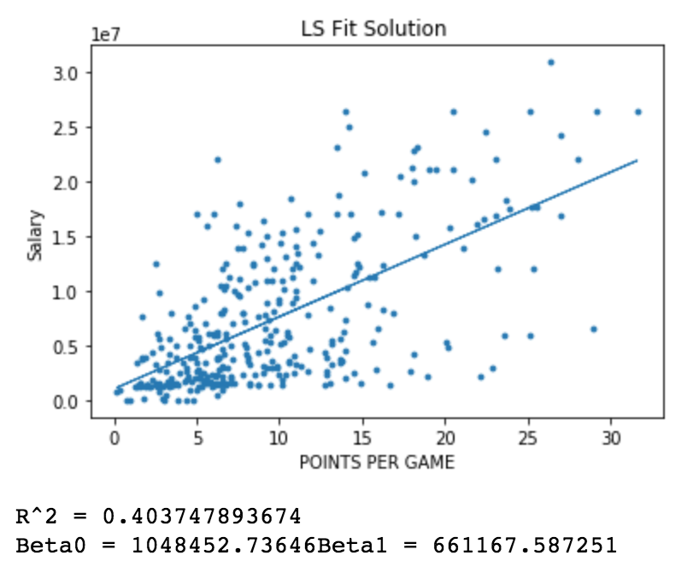
LS Fit Solution Linear Model
Does being a higher scorer means you get paid better?
Average PPG (points per game)
9.4 PPG
Lowest PPG
0.2
Highest PPG
31.6 PPG

Slide 4
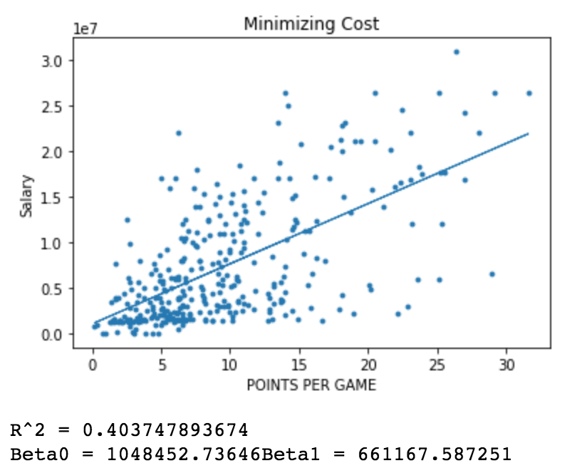
Simple Linear Regression
Same R² and similar beta values as LS Fit Solution

Slide 5
Conclusion From Linear Model
After minimizing the cost function, R² values as well as beta0 and beta1 are the same.
For some players, the higher they score, the more they get paid
There are many over paid players who aren’t great scorers
Similarly, many great are also underpaid

Slide 6
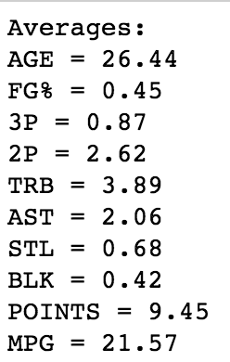
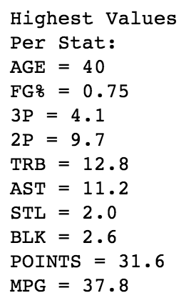
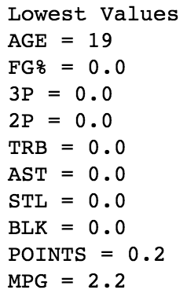
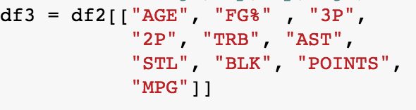
Multiple Linear Regression
Choose main features that determine how good of a player someone is (defense + offense)
10 Features

Slide 7
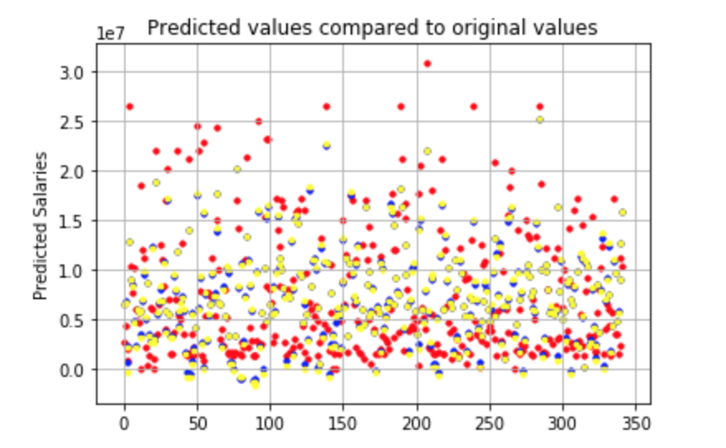
Multiple Linear Regression
Without transforming the features, the results are very scattered
Salaries fluctuate a lot!
Predicted salaries do overlap a little with actual salaries
Other factors are the cause of outliers in data

Slide 8
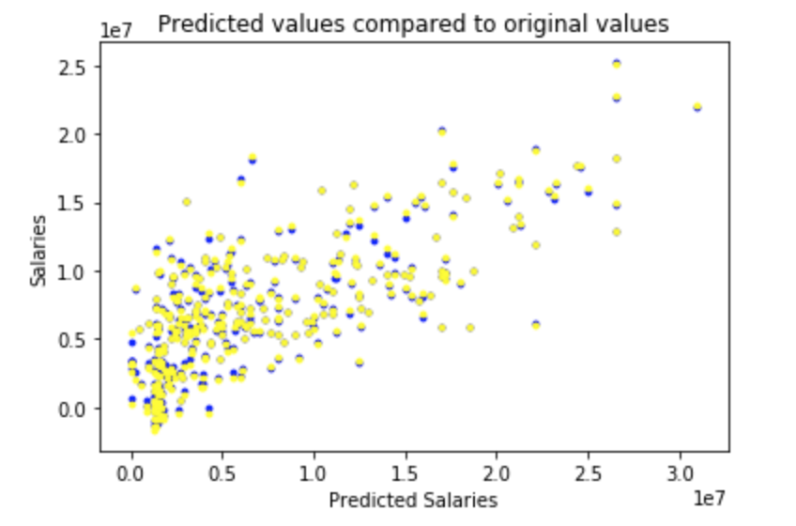
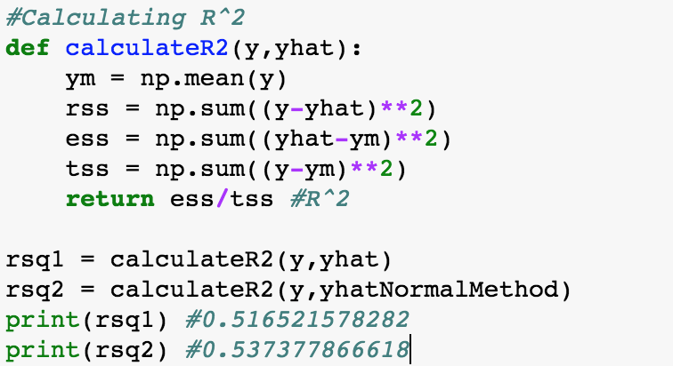
R² For Multiple Regression
R² values are higher than linear regression with one feature
Blue and yellow dots represent predicted values vs Salaries

Slide 9
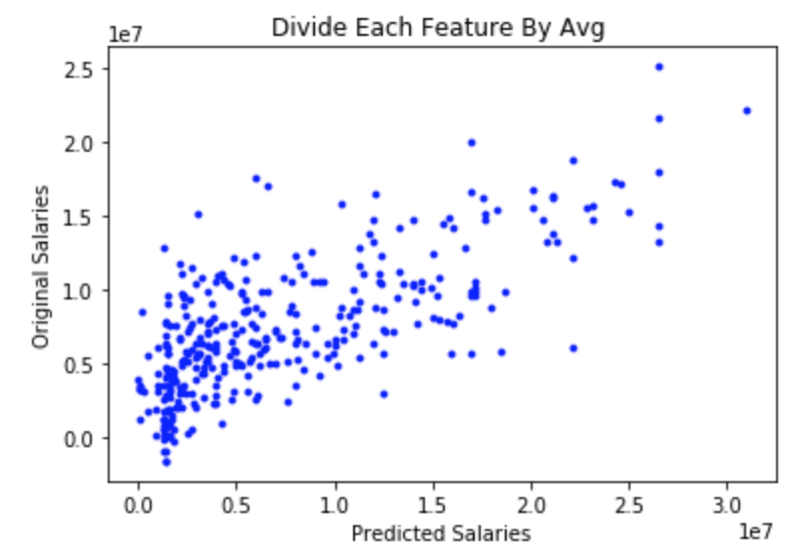
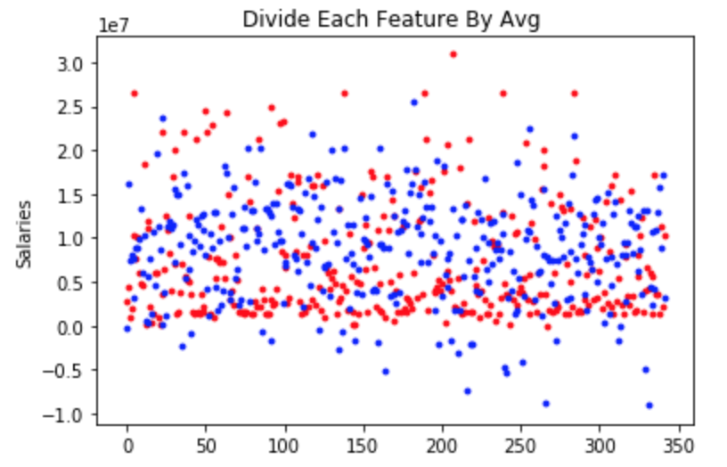
Feature Transformation
Mean Normalization
R² value decreases
Divide each feature by its average
R² value decreases

Slide 10

Conclusion
After trying many different transformations and features, it seems the correlation between a good player vs Salary isn’t really there

Slide 11
Lasso Regression Method
Goal: get coefficients that better match the data based off errors
Feature Scaling has minimal effect even though test errors are increasing.

Slide 12
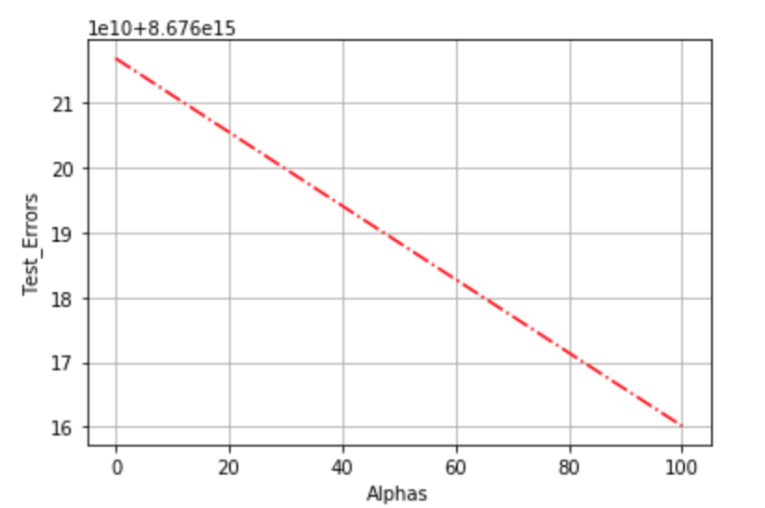
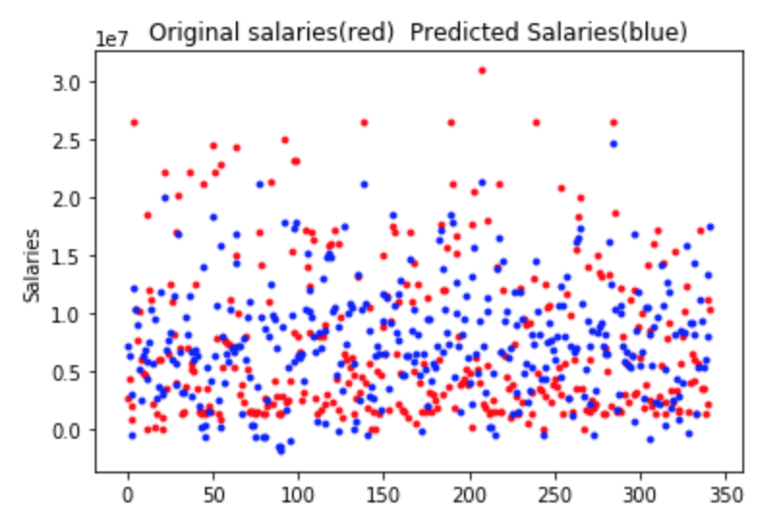
No Feature Scaling
Test error decreases
R² value is better than multiple regression
0.5543

Slide 13
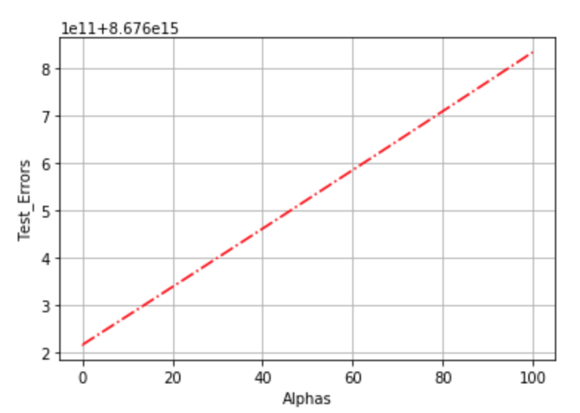
Feature Scaling
Set each value of x between 0 and 1
Test Errors Increase
R² has value of 0.5541

Slide 14
Conclusion
Many factors are considered when offering an NBA player his salary
Not constrained by how well of a player he is
Other factors
Popularity in social media
Brand Endorsements
Position the player plays
City he plays in – NYC vs Oklahoma city

